Slide 1
CALIFORNIA HOUSE PRICE PREDICTION
CSP571-Data Preparation and Analysis

Slide 2
By
Atharva Nirali (A20517247)
Neha Ramesh Gawali (A20523722)
Vaishnavi Mule (A20516627)
Vikas Reddy Nomula (A20539316)

Slide 3
Research issues
Feature Selection and Engineering
Handling Categorical Variables
Model Selection and Complexity
Overfitting and Underfitting
Handling Heterogeneous Data
Model Interpretability
Evaluation Metrics

Slide 4
Findings
Feature Importance:
Identified key features influencing house prices in California.
Analyzed the importance of features such as location, size, amenities, etc., in predicting house prices.
Correlation Analysis:
Explored correlations between various features and the target variable (house prices).
Identified strong and weak correlations that impact the prediction model.
Model Performance:
Evaluated the performance of different machine learning models for house price prediction.
Compared regression models like Linear Regression, Decision Trees, Random Forest, etc.

Slide 5
Future Scope
Enhanced Feature Engineering:
Explore and incorporate additional relevant features that could contribute to more accurate predictions.
Advanced Modeling Techniques:
Explore deep learning models such as neural networks for capturing complex patterns in the housing data.
Deployment on Cloud Platforms:
Explore deployment on cloud platforms such as AWS, Azure, or Google Cloud for scalability and accessibility.

Slide 6
Data Pipeline
Pipeline Construction
We construct a data processing pipeline that includes all the necessary data cleaning and transformation steps. This pipeline will ensure that the data is processed consistently for both training and testing datasets.

Slide 7
Data Pipeline
Data Loading and Library Setup
Exploratory Data Analysis (EDA)
Numeric Columns Histograms
Income Category Creation
Stratified Sampling
Data Analysis Visuals

Slide 8
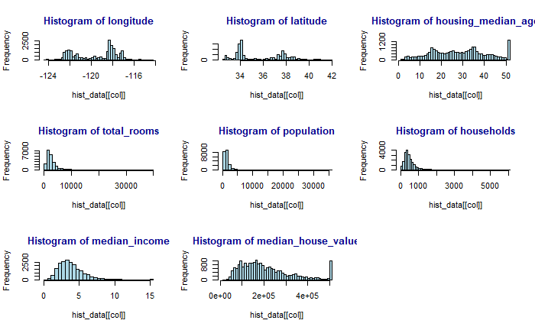
Data Analysis

Slide 9
Data Preprocessing and Transformation
Data Loading and Exploration:
Loaded libraries including caret, randomForest, rpart, dplyr, and corrplot.
Read the dataset (housing.csv) into the variable housing.
Displayed the first few rows of the dataset using head(housing) for initial understanding.
Histograms for Numeric Columns:
Selected only numeric columns for creating histograms.
Checked for missing values in numeric columns and removed them if present.
Created histograms for each numeric column to visualize distribution and identify outliers.

Slide 10
Data Preprocessing and Transformation
3) Income Categories:
Created an income category variable (income_cat) based on the ceiling of the ratio of median_income divided by 1.5.
Set any income category above 5 to 5 for meaningful analysis.
4) Stratified Sampling:
Performed stratified sampling to create training and test sets.
Ensured that income categories are well-represented in both sets to reduce biased model training.

Slide 11
Data Preprocessing and Transformation
4) Data Visualization:
Visualized geographic data using a scatter plot of longitude and latitude.
Adjusted point size based on population and included a legend for better interpretation.
5) Data Analysis:
Utilized histograms, scatter matrix, and scatter plots for numeric variables to gain insights into distribution, skewness, and variable correlations.
Examined correlation coefficients, highlighting a high correlation between "households" and "total_bedrooms," as well as "households" and "total_rooms."
Acknowledged the potential issue of multicollinearity but decided to retain the covariates due to their potential influence on home pricing.

Slide 12
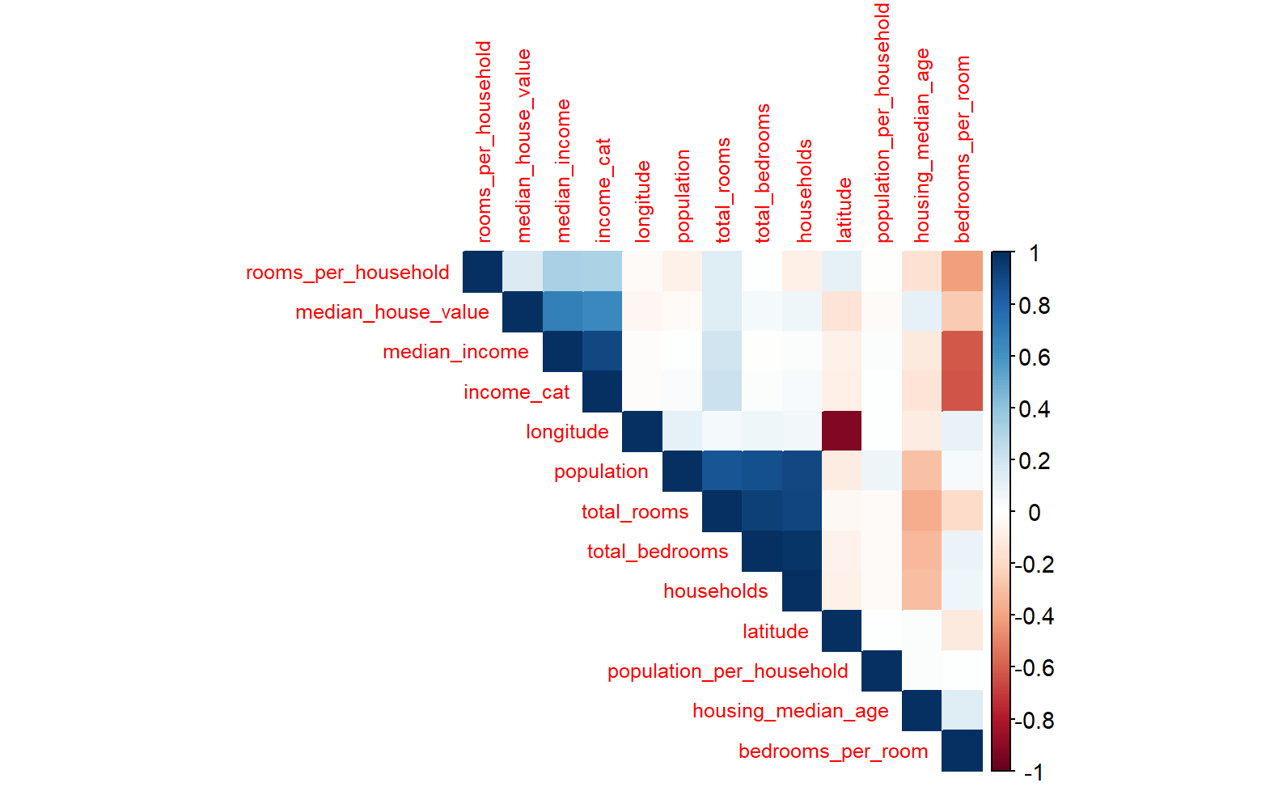
Correlation Metrics

Slide 13
Model Processing
Feature engineering
Imputation
Binning
One-hot Encoding
Feature Selection
Evaluation Metrics
Model Selection
Test Train Split

Slide 14
Model selection
- Comprehensive exploration of model subsets
- Construction of three distinct models for information extraction
- Fundamental additive model:
- Incorporates all variables
- Grasps individual impact of each predictor
- Second model:
- Introduces two-way interactions among variables
- Captures nuanced relationships
- Third model:
- Extends scope to three-way interactions
- Provides a nuanced and intricate representation
- Foundation for nuanced assessment
- Guides feature and interaction selection for overarching modeling strategy.

Slide 15
Linear Regression

Slide 16
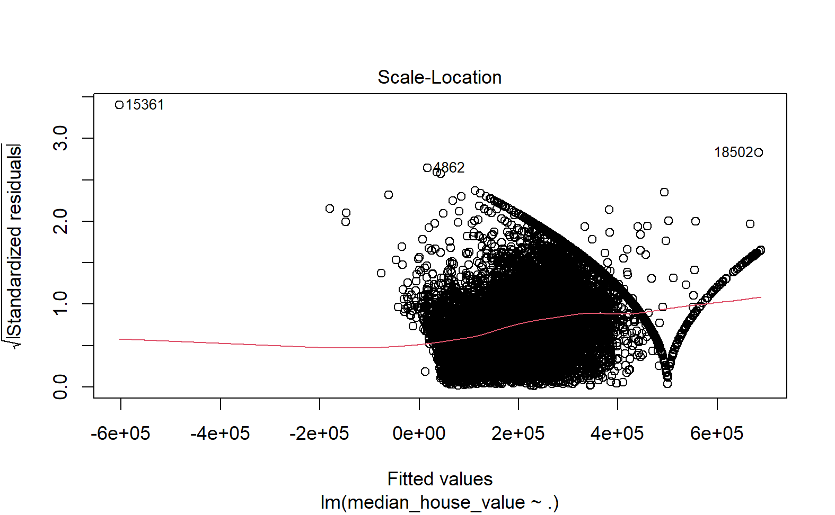
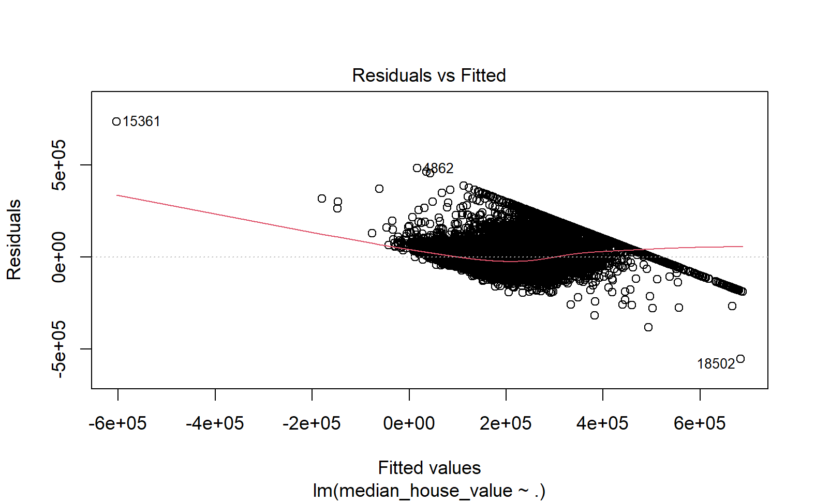
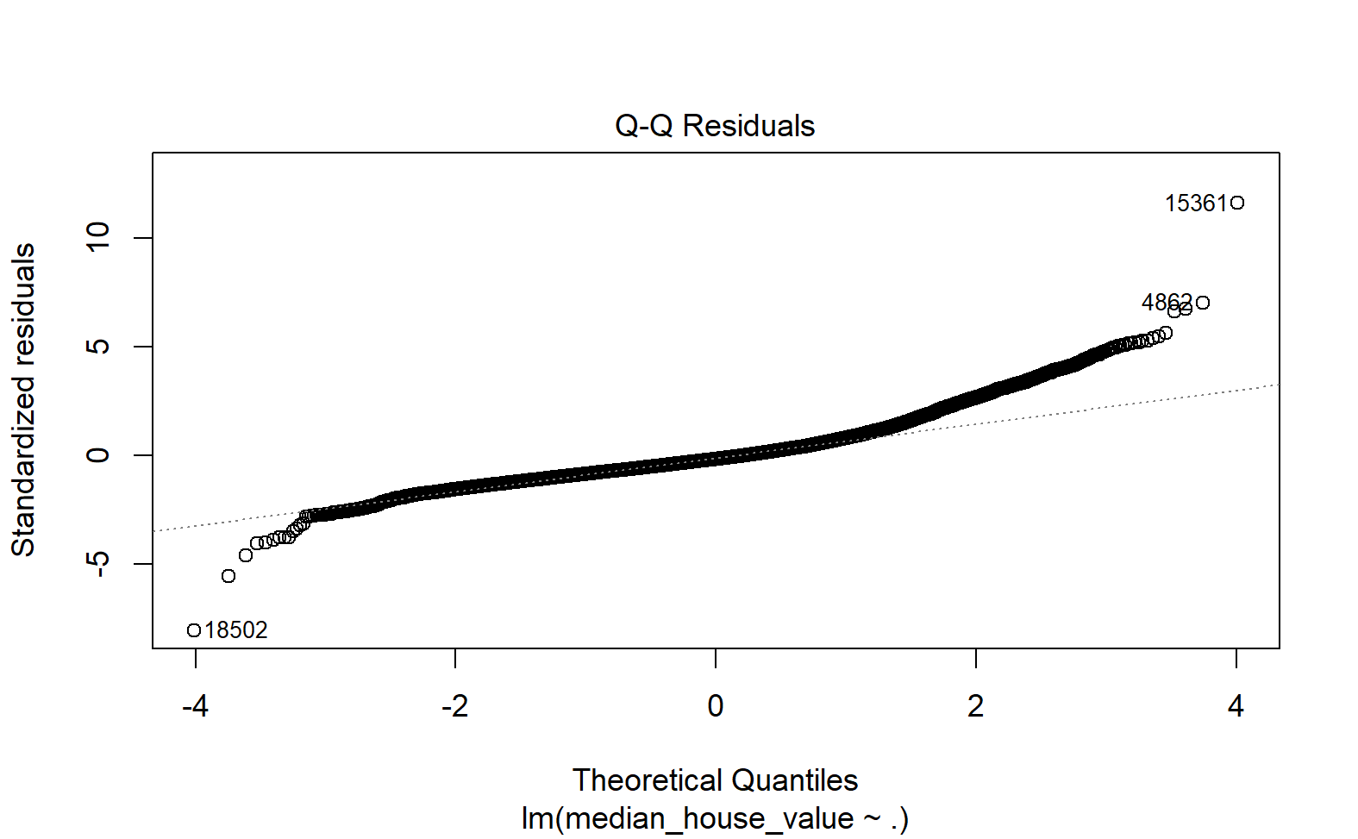
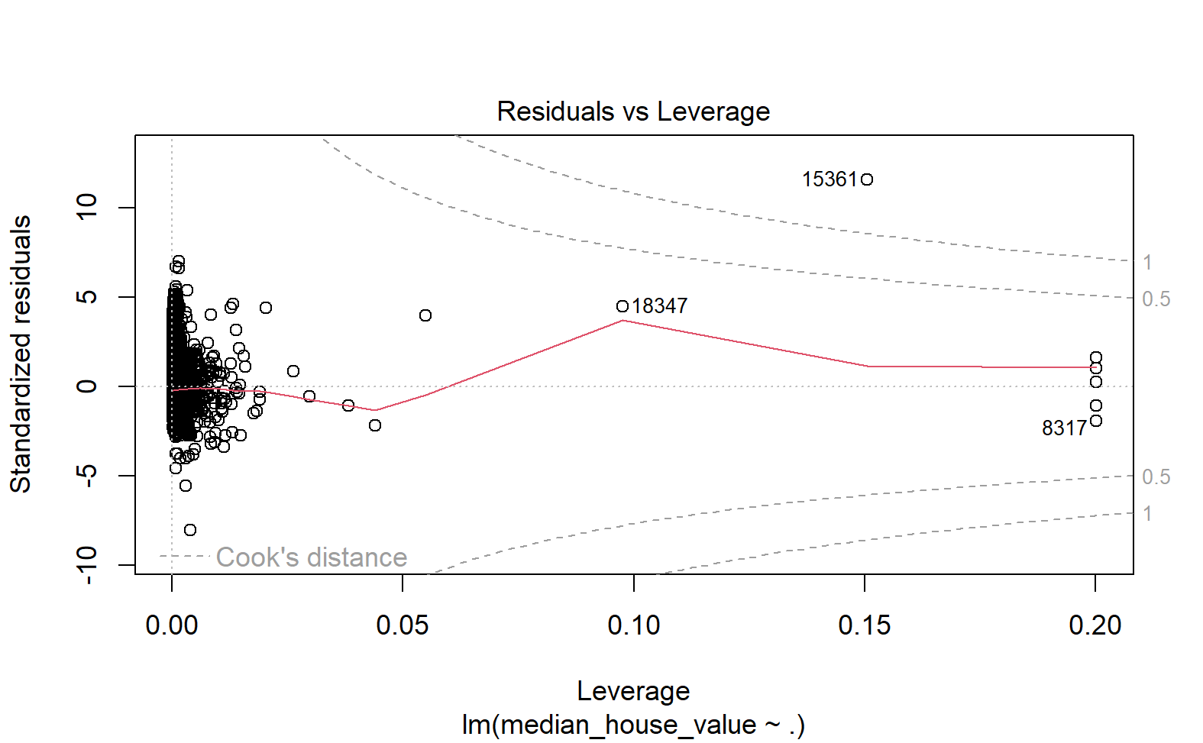

Slide 17
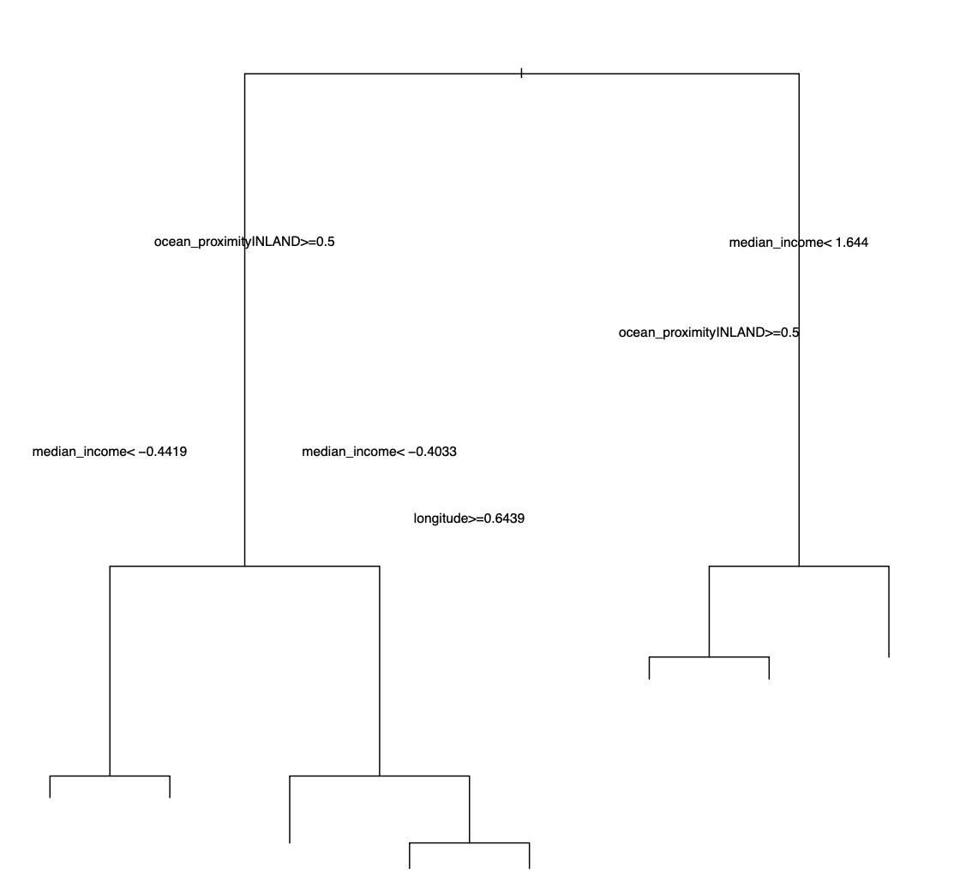
Decision tree

Slide 18
Random Forest
Call:
randomForest(formula = median_house_value ~ ., data = housing_prepared, ntree = 100)
Type of random forest: regression
Number of trees: 100
No. of variables tried at each split: 4
Mean of squared residuals: 2655370925
% Var explained: 80.13

Slide 19
Final Output
Min. 1st Qu. Median Mean 3rd Qu. Max.
49433 131923 191101 207110 259522 500001
> final_rmse <- sqrt(mean((final_predictions - y_test)^2))
> print(final_rmse)
[1] 52207.11

Slide 20
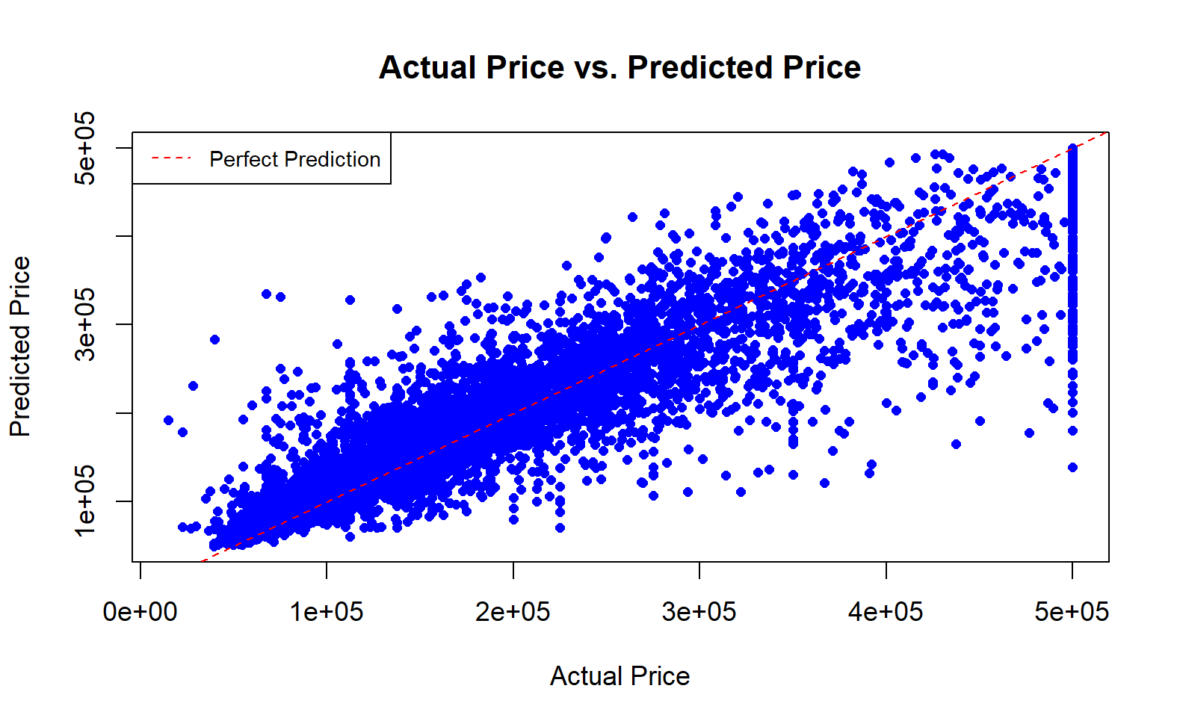
Actual vs Predicted Price

Slide 21
Conclusion
Explored Linear Regression, Decision Tree, and Random Forest models for housing price prediction.
Linear Regression highlighted relationships: key variables - latitude, longitude, median income.
Decision Tree emphasized non-linear patterns: pivotal predictor - median income, followed by inland proximity.
Random Forest excelled with 80.13% variance explained, emphasizing median income, inland proximity, and coordinates.
Consistent trend across models: Median income crucial in predicting housing prices.
Geographic patterns significant: Latitude, longitude, and proximity to specific areas influential.
Random Forest's superiority showcased the effectiveness of ensemble methods.
Overall insights emphasize nuanced factors in housing price dynamics.
Recommendations: Prioritize median income and acknowledge the impact of geographic patterns in predictive modeling.

Slide 22
Project Repository - Link
Please find all the documentation and code files here. Link
Link url -
https://drive.google.com/drive/folders/1rp0pG7ELJBivdTgy73QWKAq6pEX4zM4d?usp=drive_link

